Slide 1

EMPLOYEE ATTRITION ANALYSIS
This presentation examines key factors driving attrition to improve retention for Frito Lay
Presented by Mohammad Meraj, Senior Advisor - DDSAnalytics

Slide 2

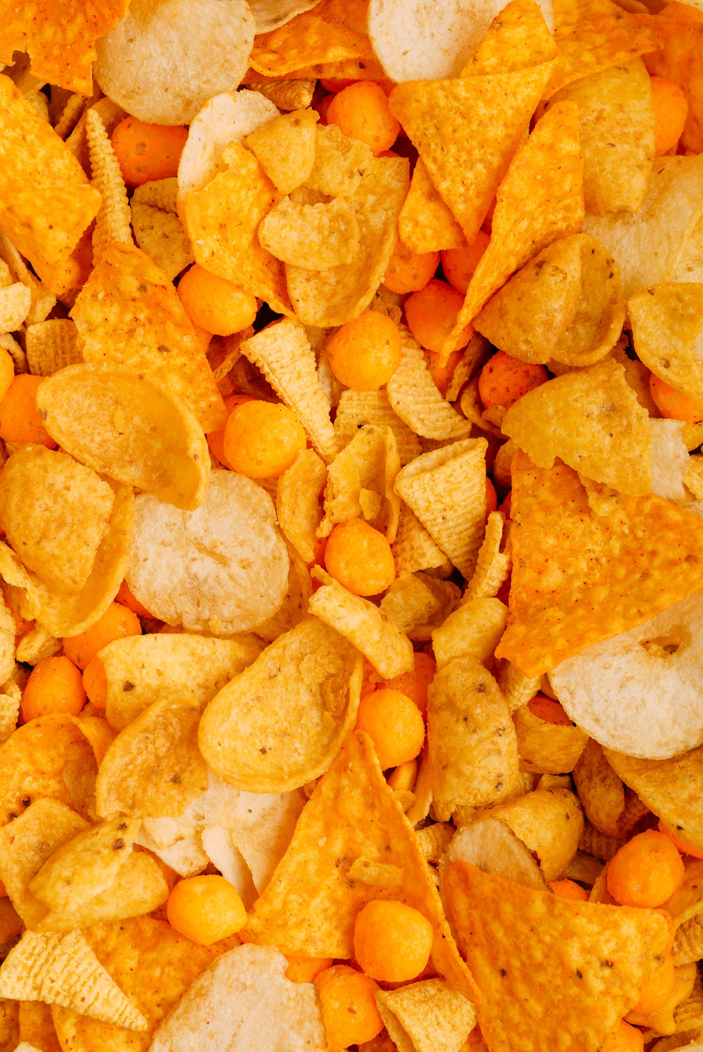





AGENDA
Review & Prepare the Data
Boxplots of Numeric Variables Grouped by Attrition
Chi-Square Test and Contingency Tables
Predictive Models (KNN & Naive Bayes)
Highest Job Satisfaction
Highest Monthly Income
Linear Regression Model for Monthly Income

Slide 3
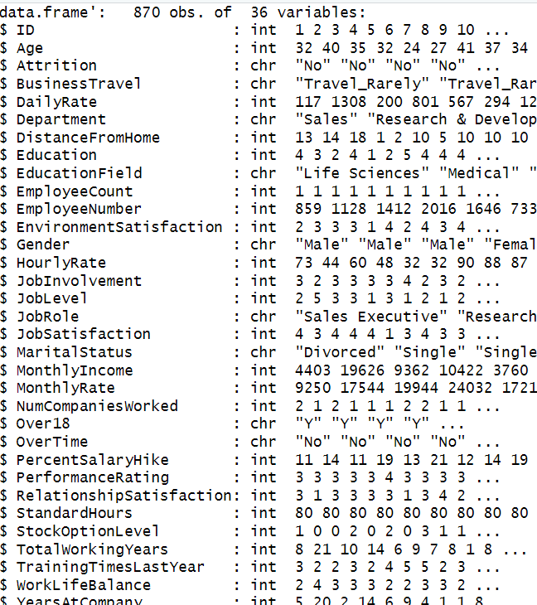
REVIEW AND PREPARE THE DATA
870 employees were evaluated
36 different attributes were considered
No missing values

Slide 4
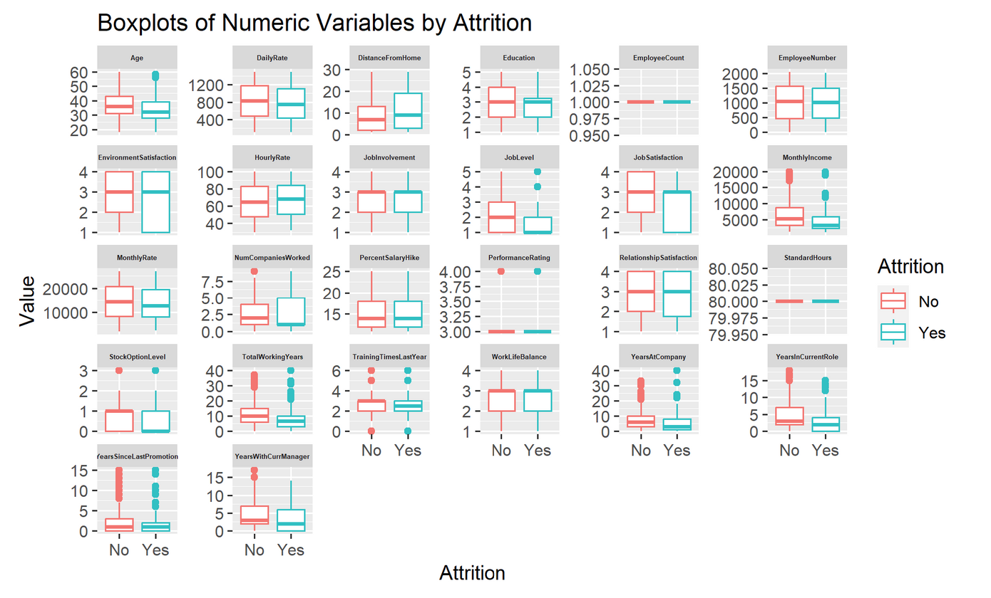
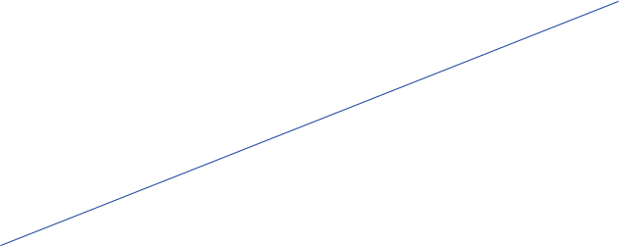
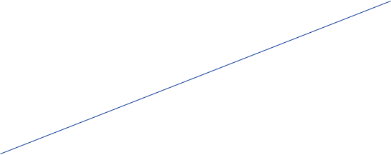
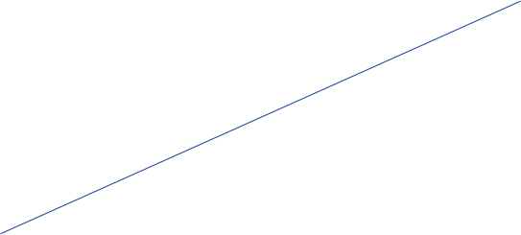
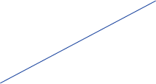
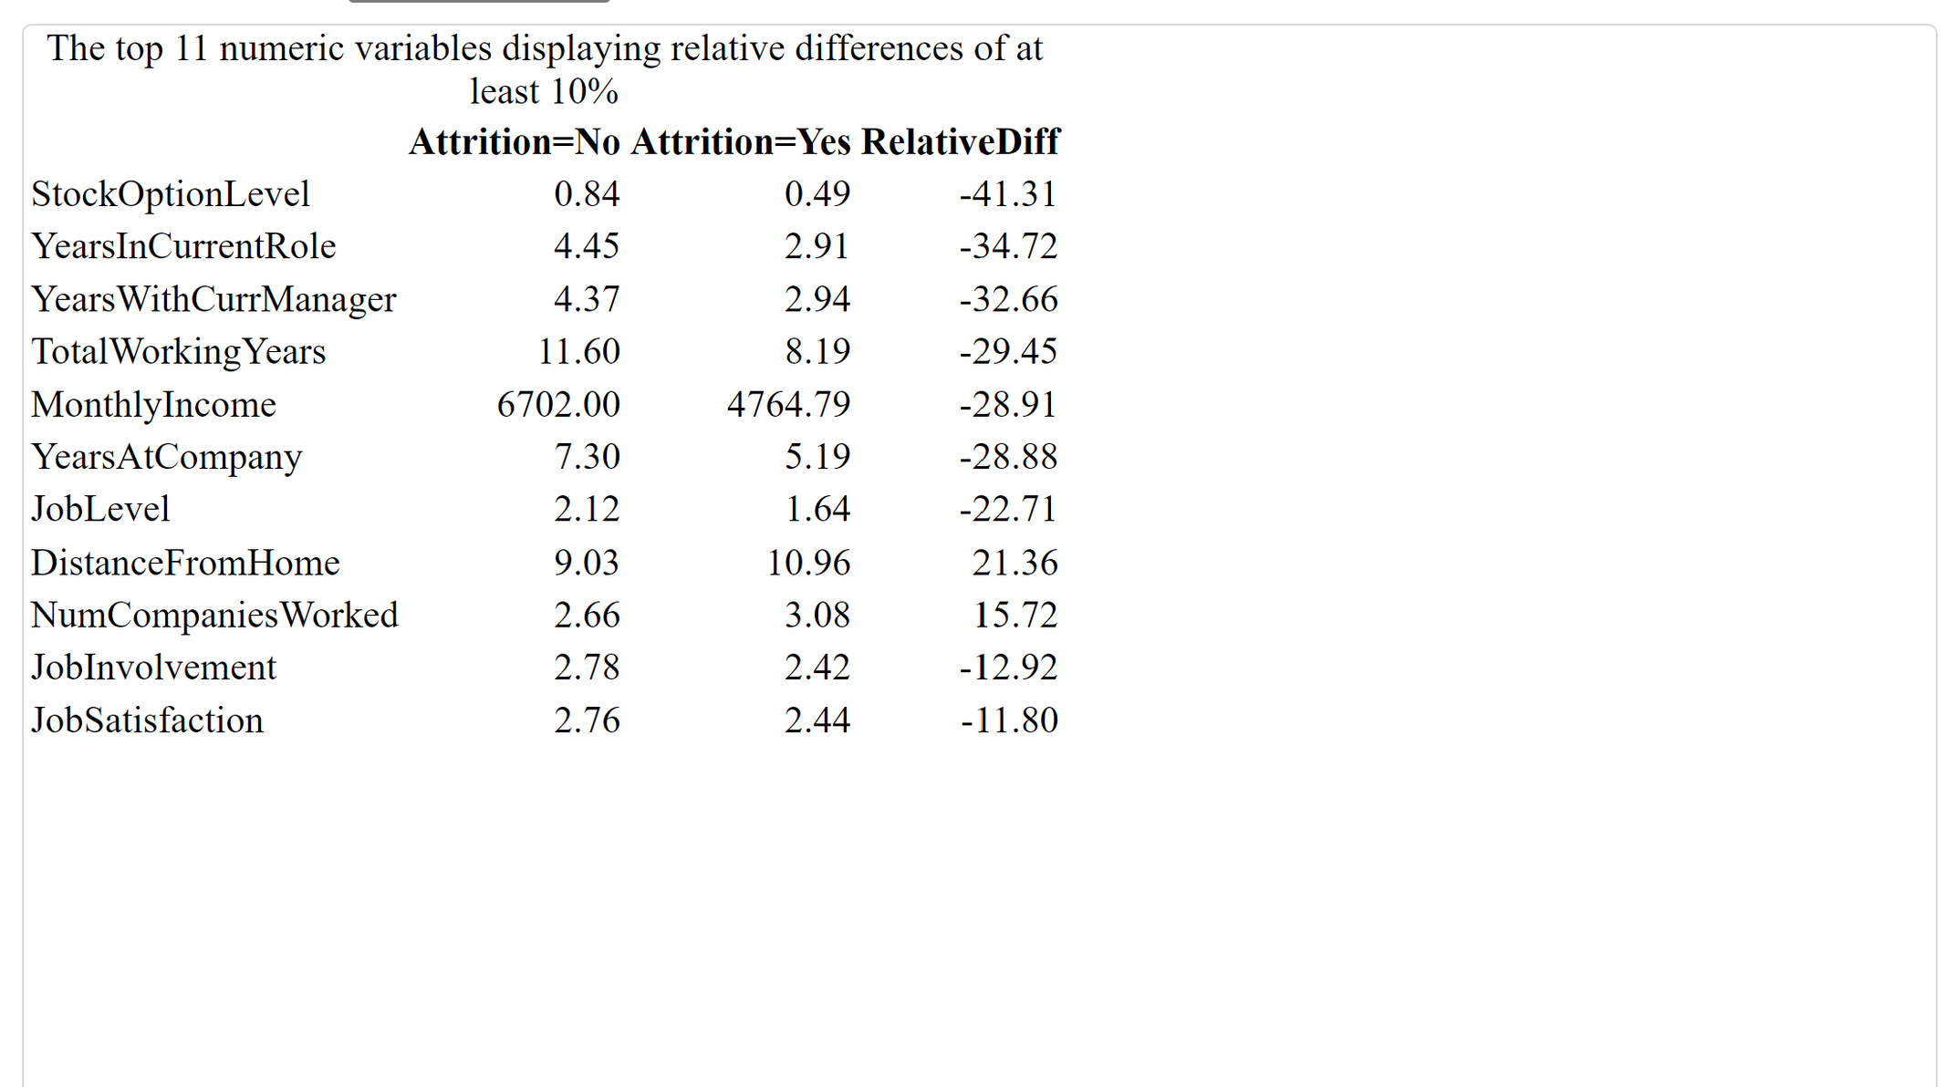
KEY FACTORS THAT MAY CAUSE ATTRITION
StockOptionLevel
TotalWorkingYears
YearsWithCurrManager
MonthlyIncome
YearsInCurrentRole

Slide 5
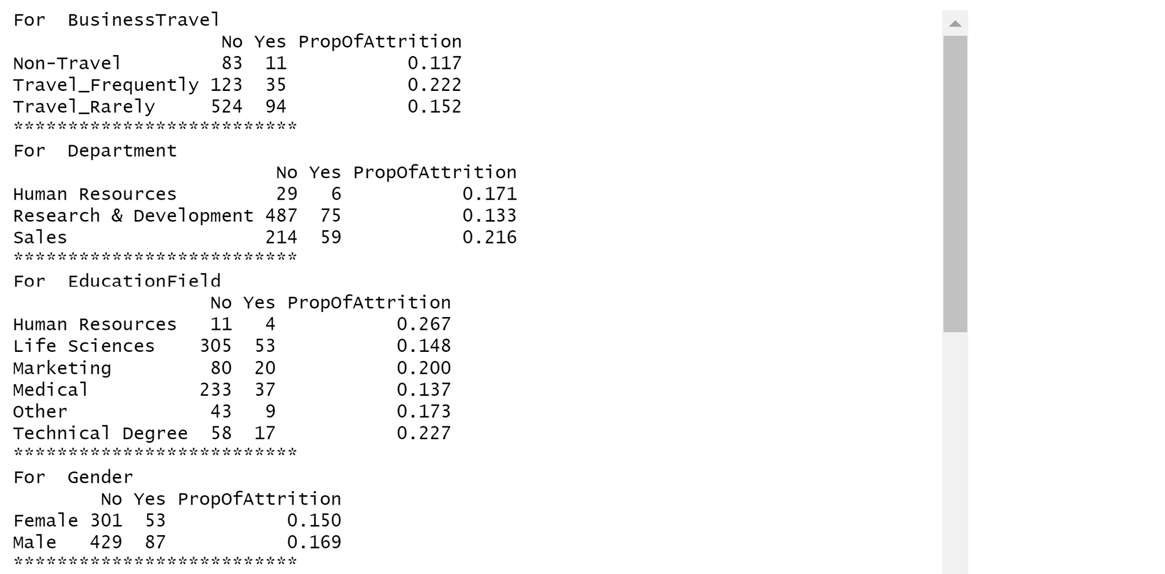

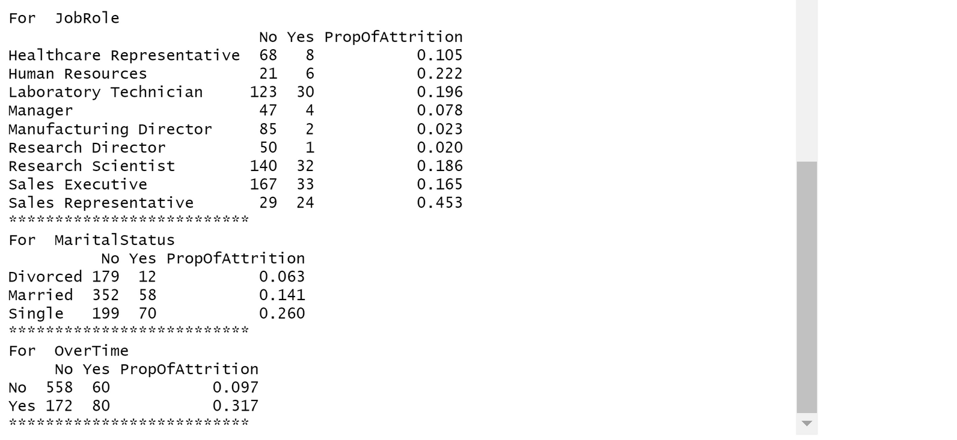
P-VALUES AND THE CONTINGENCY TABLES
There are higher proportions of attrition among people with overtime and those who work as sales representatives. Thus, the variable "OverTime" and "JobRole" are highly related with attrition.
P-values of Chi-Square Test of Independence with Attrition
BusinessTravel
0.0499
Department
0.0094
EducationField
0.2682
Gender
0.5151
JobRole
0.0000
MaritalStatus
0.0000
OverTime
0.0000

Slide 6



TOP 3 FACTORS
Stock Option Level
Years In Current Role
Overtime
Relative Differences: -41.31
Relative Differences: -34.72
Prop of attrition: 0.317

Slide 7



NAIVE BAYES MODEL
82% accuracy on training data
85% sensitivity
63% specificity
The NB model achieved good performance with 82% accuracy on the training set.
The model correctly identified 85% of positive cases, indicating good sensitivity.
The model had a moderate false positive rate with 63% specificity.
Build the model using the top 11 numerical variables which have a relative difference at least 10%, and 5 categorical variables that has a p-value less than 0.01

Slide 8



KNN MODEL
High model accuracy
Good sensitivity
Moderate specificity
The KNN model achieved an accuracy of 89% on the training data
The sensitivity of the model was 94%, indicating a high true positive rate
The specificity was 65%, showing the model's moderate ability to detect true negatives
Build the model using the top 11 numerical variables which have a relative difference at least 10%.
The KNN model demonstrates strong predictive performance overall, with high accuracy and sensitivity but room for improvement in reducing false positives.

Slide 9

JOB SATISFACTION
Healthcare representatives had an average job satisfaction score of 2.83 out of 5 points, which was 0.04 to 0.1 points higher than other roles analyzed. This indicates healthcare representatives have a slightly higher level of satisfaction with their jobs compared to sales, research, and manufacturing roles.

Slide 10

MONTHLY INCOME
The manager job role had the highest average monthly income of $17,197 according to the data. A multiple linear regression model was built to predict monthly income using job characteristics as predictors.

Slide 11



LINEAR REGRESSION MODEL
Model predicts employees' monthly income
Used predictors like business travel, job level, role
Achieved RMSE of $1,046 on training data
A linear regression model was built and trained on employee data to predict monthly income
The model used predictors like business travel frequency, job level, job role and others
On the training data, the model achieved a root mean squared error of $1,046
The linear regression model showed reasonable performance in predicting monthly income on the training data
The variables "Over18", "EmployeeCount" and "StandardHours" won't be included as predictors in the model since those variables only has 1 value.

Slide 12

THANK YOU!
QUESTIONS
emerajmohammadi@smu.edu

